Slide 1

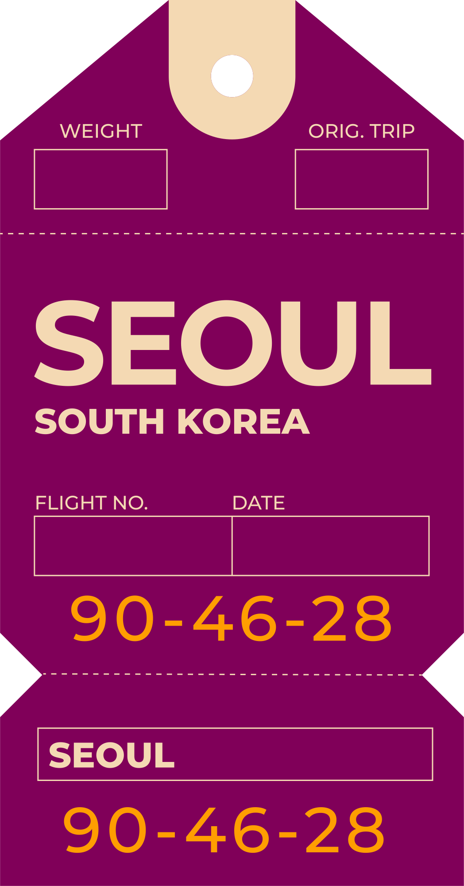



Travelling
Salesman problem
Using genetic
Algorithm
Algorithm Spring2024
Presented by: 박상범(21800272), 방은주(22100331), 황은지(22100809), 구나영(22101006)

Slide 2




PRESENTATION OUTLINE
?Understanding Genetic Algorithm
(Task 1)
Find the Shortest Route for the United Parcel Service (UPS)
Find the Best Route for BLACKPINK World Tour

Slide 3
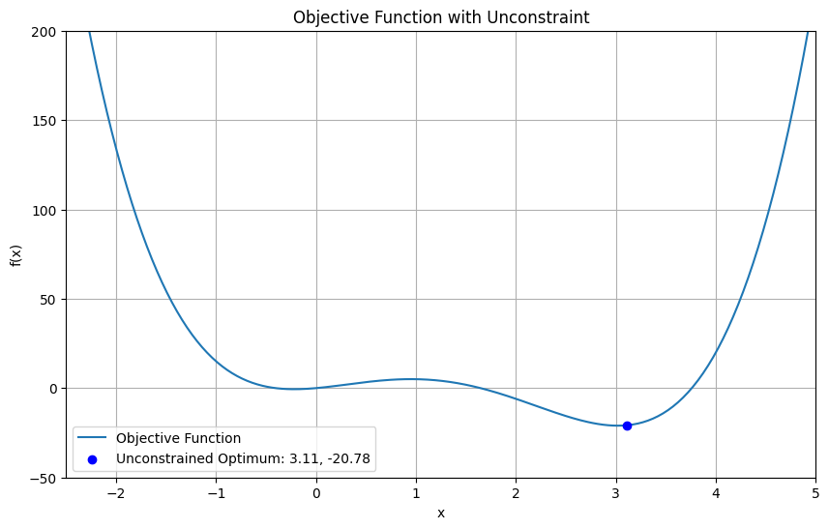
UCONSTRAINT
Uncontraind data: 3.0323751244638713 , -21.00464598622979

Slide 4
Q. How did you design the stopping criteria and what is the optimal value?
Set a variable named “previous_best_score” to store the best value from the previous generation
The role of variables: measuring differences from previous generations
Stop Criteria: Best value in previous generation - Best value in current generation < 0.000001

Slide 5
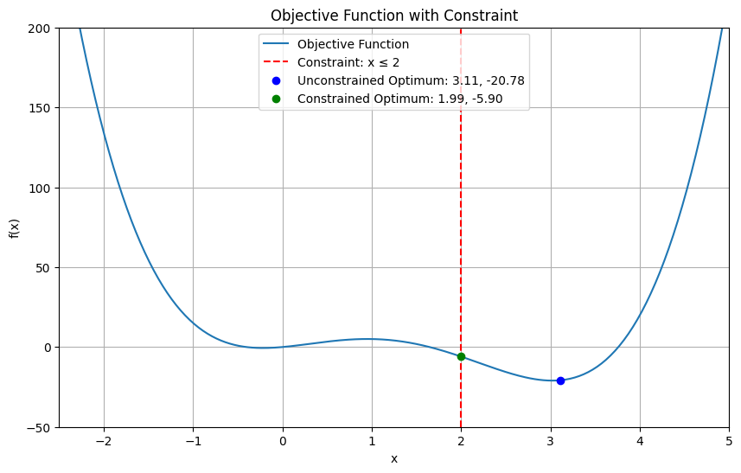
CONSTRAINT
Contraind data: 1.8931645870650984 , -4.0228382178696656

Slide 6
Q. How did you account for constraints in the genetic algorithm?
Unconstraint genetic algorithm: The bounds parameter is used to define the constraint as the range of the variable.
Constraint genetic algorithm: Using the is_feasible() function,
Using the evolve() function

Slide 7
Q.Why constrained & unconstrained optimal points are different?
Constraints: x ≤ 2
The solution space is limited by constraints
Hyperparameters: crossover rate, mutation rate of generations

Slide 8



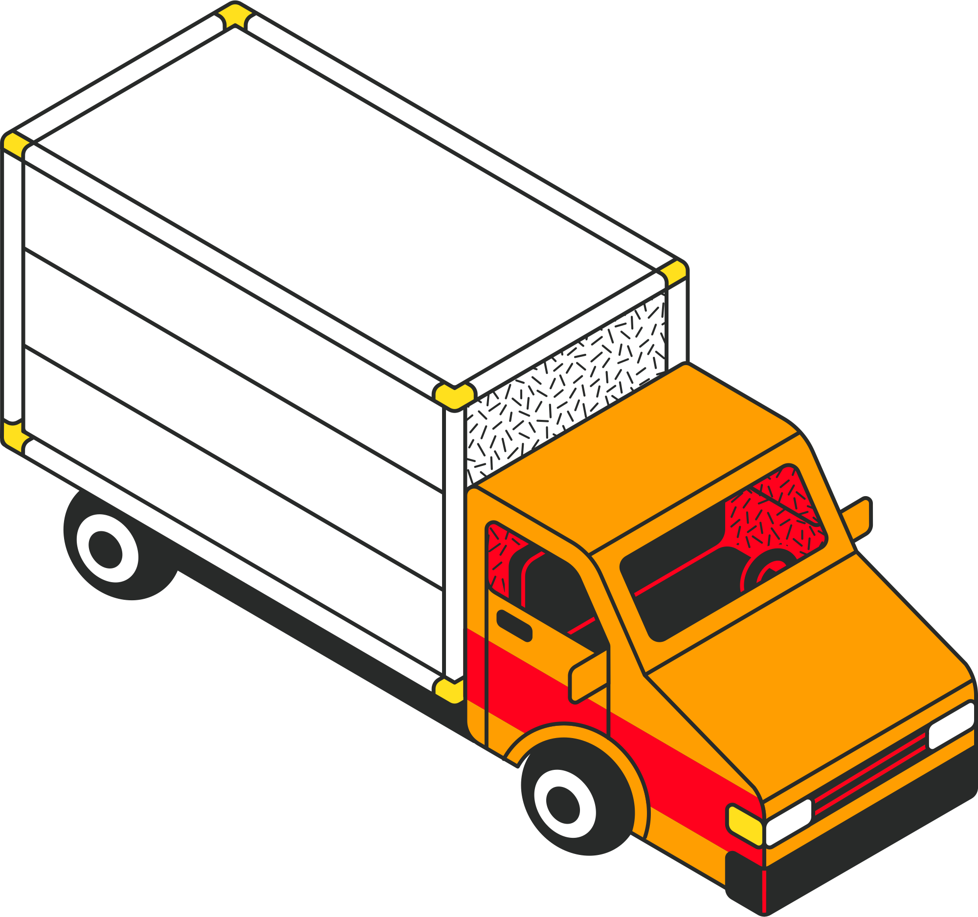


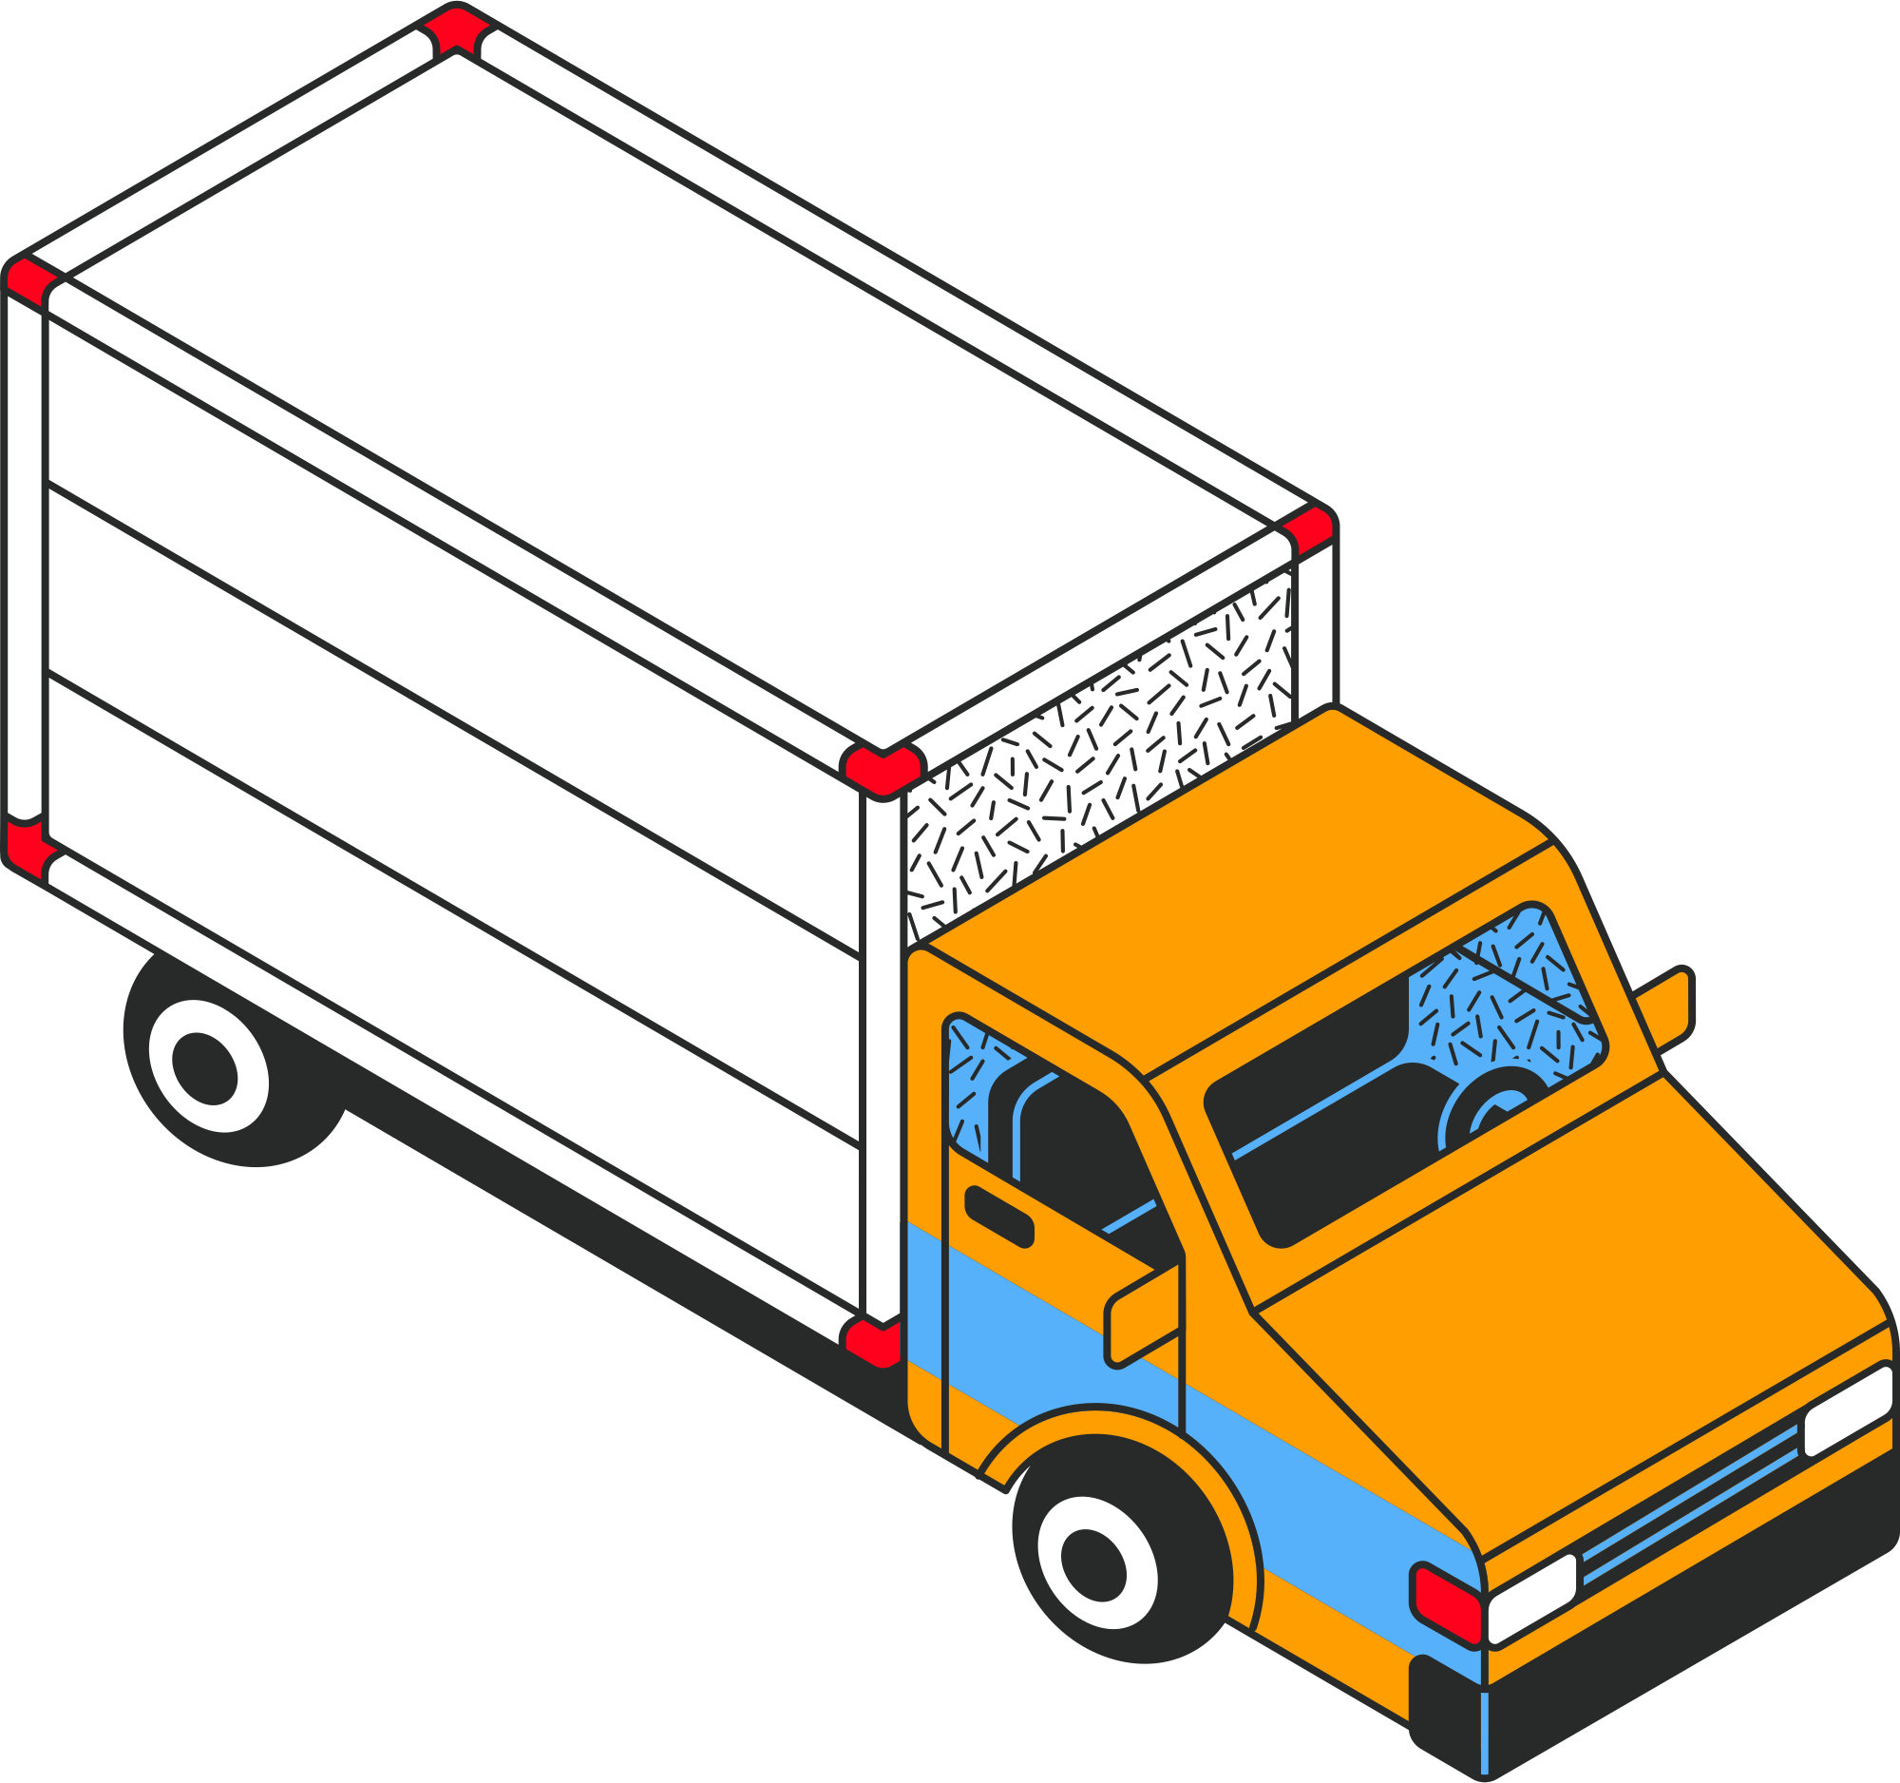
UNITED PARCEL SERVICE (UPS)
To find the shortest route, visiting each point once from origin (index 0 point)
Choose 3 different cities, manage planning for drivers

Slide 9
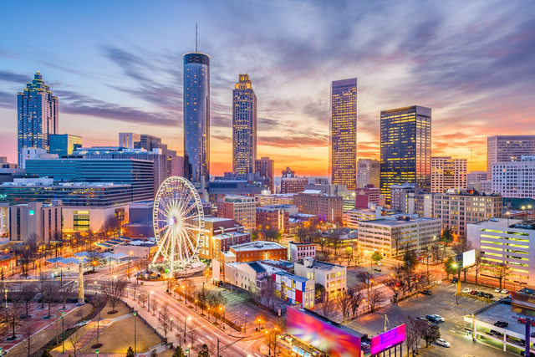


?Atlanta, GA
New York, NY
Philadelphia, PA
https://a.cdn-hotels.com/gdcs/production114/d1629/63a8dbe5-e678-4fe4-957a-ad367913a3fa.jpg
https://cdn.britannica.com/61/93061-050-99147DCE/Statue-of-Liberty-Island-New-York-Bay.jpg
https://cdn.britannica.com/42/94242-050-0BC6FC52/Philadelphia.jpg

Slide 10
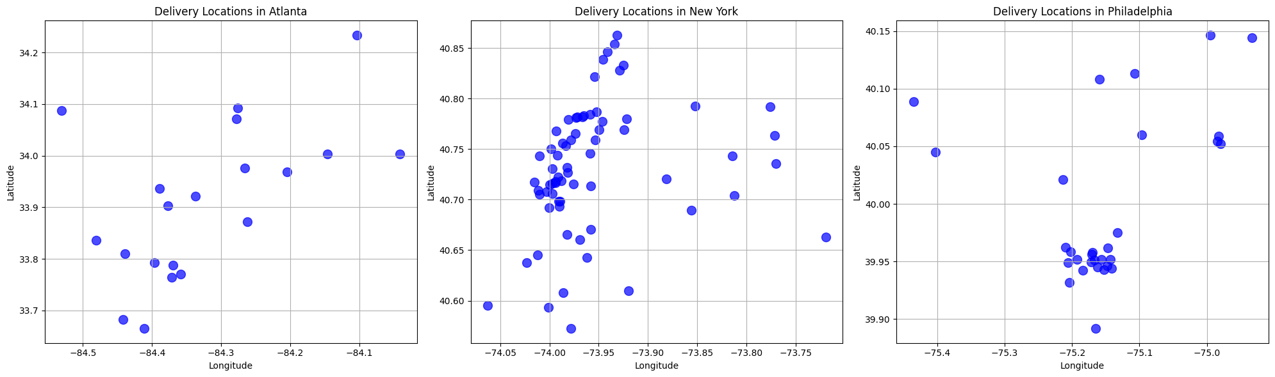
?Atlanta, GA
New York, NY
Philadelphia, PA

Slide 11
Implementing the Genetic Algorithm to Solve the TSP
1) Initial setup : distance_matrix, other parameters
2) Creation of individuals and population : start = index 0
3) Define evaluation function : fitness of each individual
4) Register genetic operators : Crossover, mutation, selection (tournament=3)
5) Execute genetic algorithm
6) optimal solution : Select the best individual(shortest route)

Slide 12
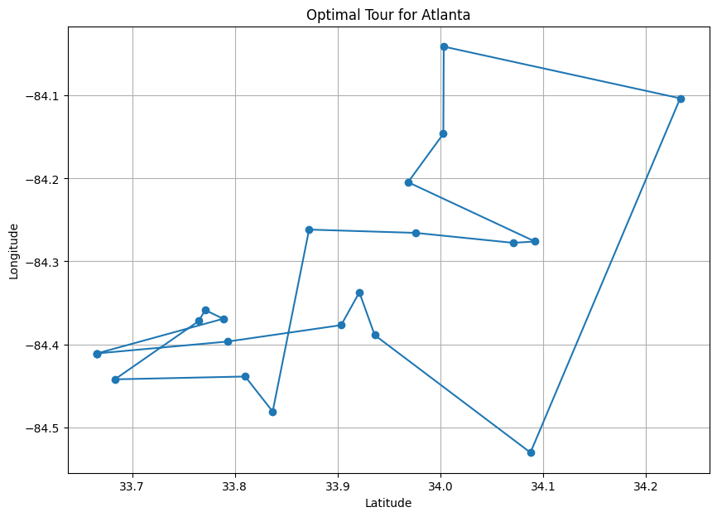
Result of Atalnata
Best tour in Atlanta: [0, 12, 10, 4, 19, 5, 3, 18, 14, 7, 15, 9, 13, 17, 11, 8, 6, 1, 2, 16, 0]
Best distance in Atlanta: 231.28 km

Slide 13
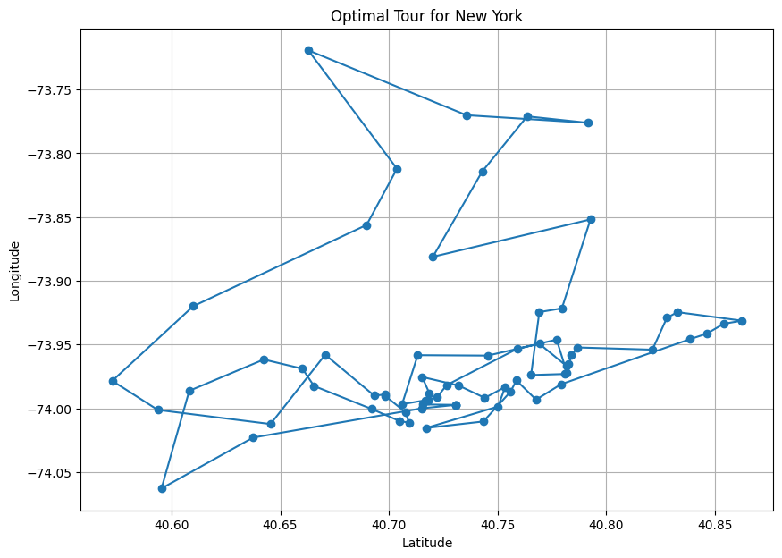
Result of New York
Best tour in New York: [0, 4, 65, 25, 33, 6, 66, 63, 5, 22, 48, 59, 24, 29, 40, 37, 10, 54, 45, 42, 21, 51, 32, 56, 9, 17, 13, 30, 43, 49, 27, 1, 26, 16, 35, 15, 60, 11, 55, 28, 20, 62, 58, 8, 57, 14, 7, 67, 52, 36, 61, 38, 50, 34, 44, 64, 47, 19, 53, 18, 12, 3, 46, 23, 2, 41, 31, 39, 0]
Best distance in New York: 203.15 km

Slide 14
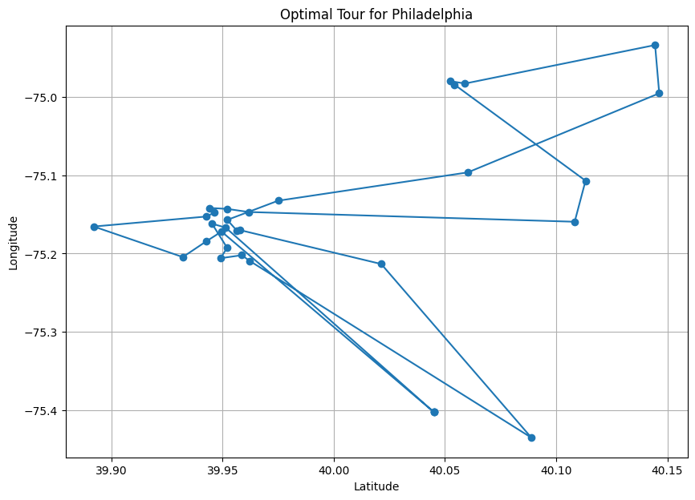
Result of Philadelphia
Best tour in Philadelphia: [0, 4, 13, 15, 28, 27, 1, 29, 5, 14, 16, 9, 2, 6, 26, 7, 11, 22, 20, 8, 12, 24, 19, 23, 18, 21, 10, 25, 3, 17, 0]
Best distance in Philadelphia: 155.72 km

Slide 15
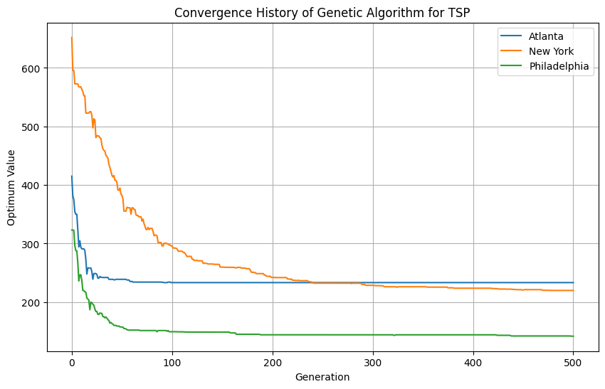
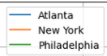
Creat a plot of Convergence History

Slide 16
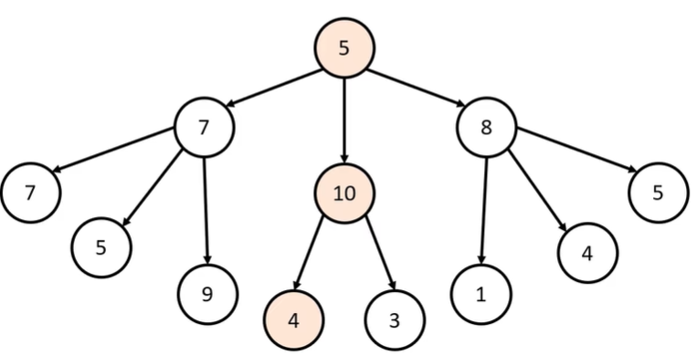

Greedy Algorithm
Concept
The steps in the Greedy algorithm mean that at each step you make choices that you think are optimal, until you finally find an overall optimal solution.

Slide 17
Implementing the Greedy Algorithm to Solve the TSP
1) Initial setup : distance_matrix, other parameters
2) Creation of individuals and population : start = index 0
3) Repeat until all cities have been visited
4) Select the next city that is the shortest distance from each city
5) Return to the arrival point
6) Add up all the paths travelled to come up with a solution

Slide 18
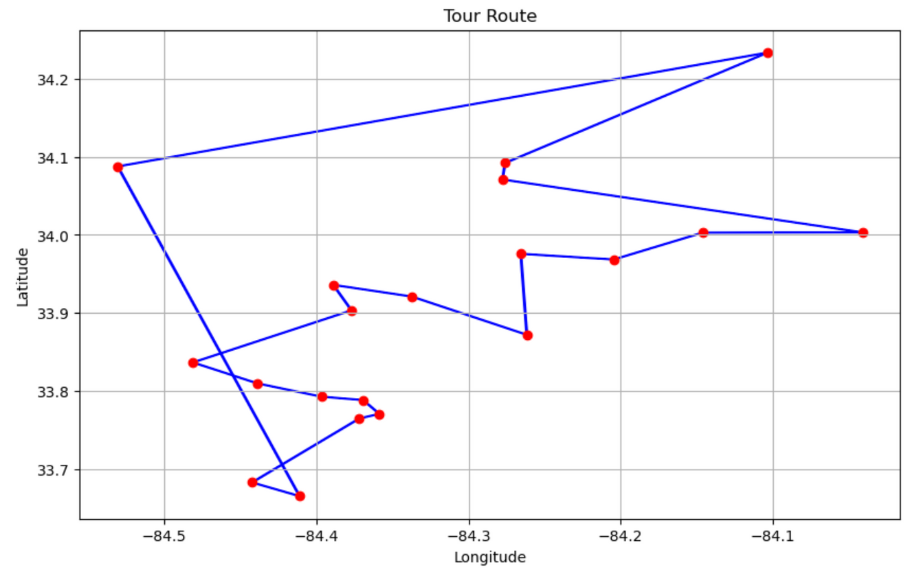
Result of Atalnata
Best tour in Atlanta: [0, 6, 1, 2, 16, 12, 8, 11, 10, 19, 4, 17, 13, 7, 14, 18, 9, 15, 3, 5, 0]
Best distance in Atlanta: 231.98 km

Slide 19
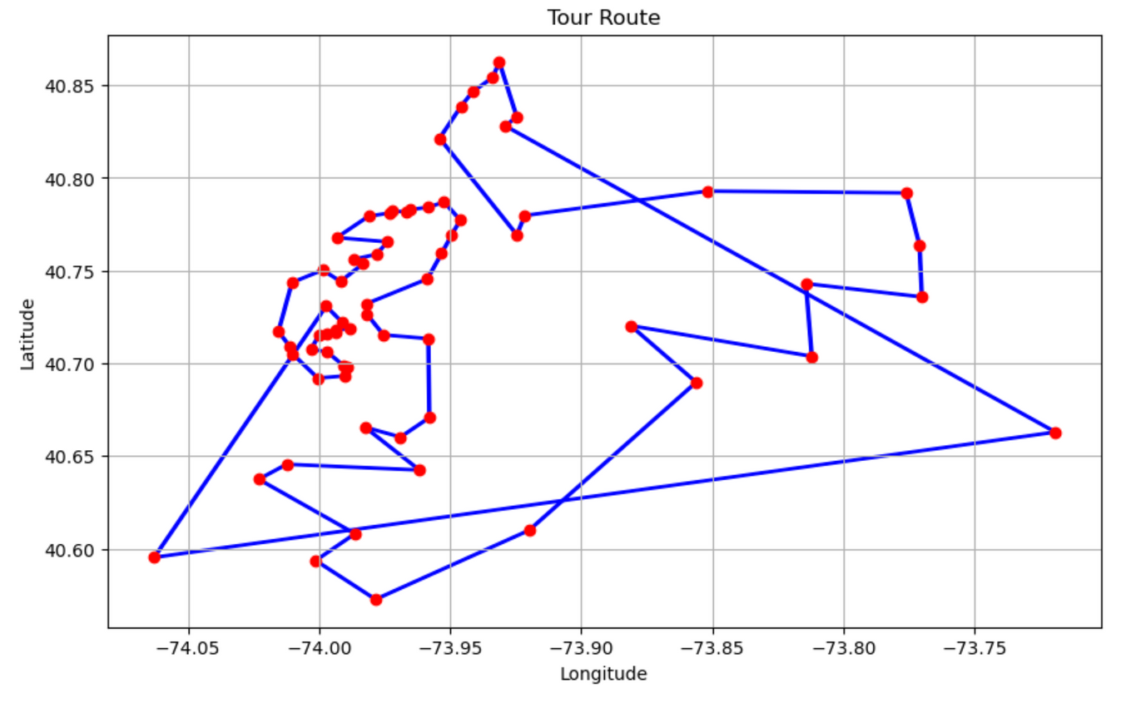
Result of New York
Best tour in New York: [0, 11, 41, 31, 55, 39, 4, 59, 28, 24, 29, 40, 5, 22, 48, 18, 53, 12, 46, 3, 19, 47, 1, 64, 44, 26, 16, 8, 57, 14, 7, 35, 58, 15, 62, 23, 60, 2, 20, 37, 66, 63, 6, 10, 65, 33, 54, 45, 42, 21, 30, 51, 13, 56, 17, 9, 43, 49, 27, 67, 34, 50, 38, 61, 36, 52, 32, 25, 0]
Best distance in New York: 202.55 km

Slide 20
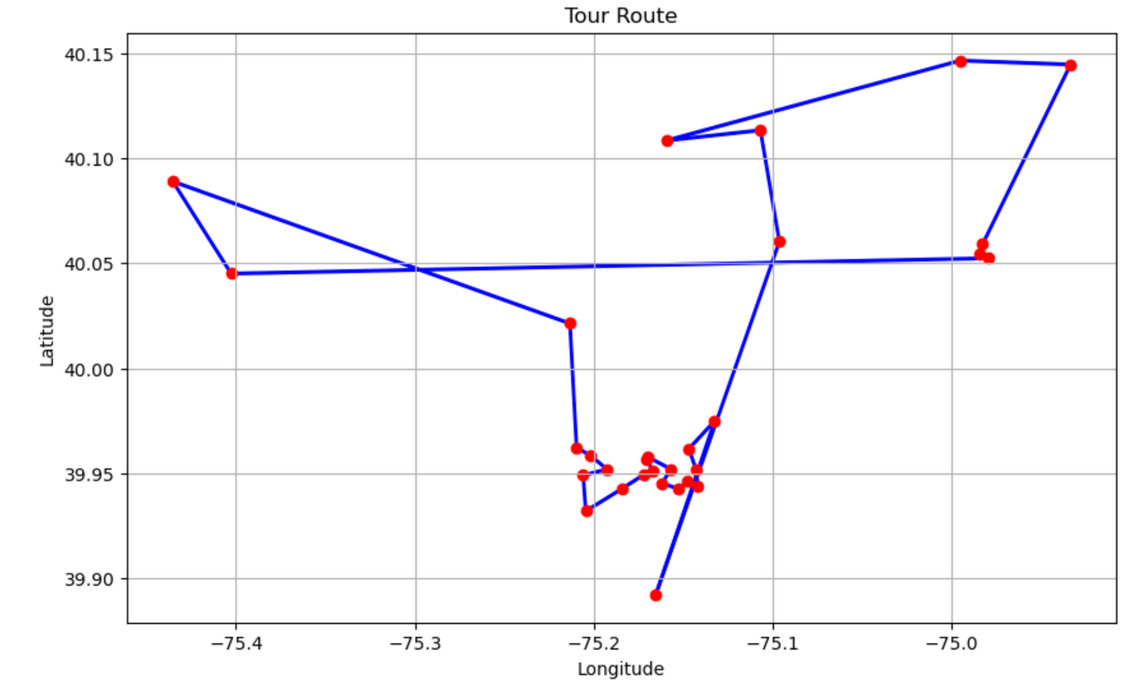
Result of Philadelphia
Best tour in Philadelphia: [0, 23, 19, 18, 21, 25, 10, 15, 13, 4, 17, 12, 24, 8, 3, 27, 1, 29, 5, 14, 20, 28, 22, 9, 16, 11, 7, 26, 2, 6, 0]
Best distance in Philadelphia: 155.12 km

Slide 21
Discussion
Q. How to improve Greedy algorithm efficiency
A . Using Different Methods
1. Finding the shortest distance
: Optimise the Greedy algorithm by directly selecting the minimum distance in the transformation matrix using Numpy's Find Minimum method.
2. Finding the city index value
: When moving on to the next city, I need a way to get the index value of that city and easily move to the next array.

Slide 22
Discussion
Q. How to improve Greedy algorithm efficiency
A . Transform DistanceAdjacencyMatrix
1. Matrix transformations
: It would have been easier to implement the algorithm if the distance transformation matrix was not a symmetric matrix, but a distance transformation matrix with duplicate values removed.
2. Converting to a dictionary value
: Simplify the Greedy algorithm by structuring the distances from city 0 to other cities into a nested list format resembling a JSON file, where city indices serve as keys and distances as corresponding values.

Slide 23
Q. Do we always get the same solution when executing the algorithm multiple times?
A. No. In each run, initialization of the population, genetic operators, and selection mechanisms induces randomness.
Q. Is solution from the genetic algorithm a global optimum?
A. No. It is not guaranteed to be the global optimum. GA = diversity and efficiency. However, the quality depends on various factors. Although it gives the best possible solution in their trial, the best one is a feasible solution, not global!
Q. Can we improve the runtime performance of genetic algorithm?
A. Yes. Appropriate data structures and memoization to reuse results can do so.
To integrate greedy decision-making heuristics, choose the best and the fittest value.

Slide 24


FINDING THE BEST
BLACKPINK WORLD TOUR SCHEDULE

Slide 25
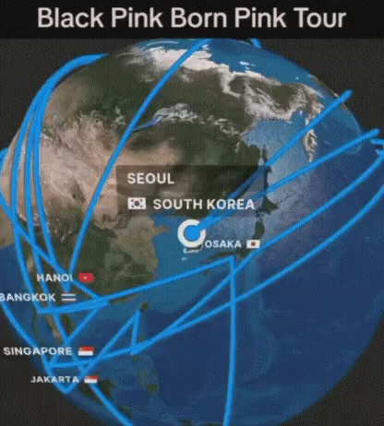
TOUR SCHEDULE
https://ext.fmkorea.com/files/attach/new3/20240109/486616/3555512868/6595771149/b38356e9cf24cb6a79d3e6eec8a42a0f.mp4?d
They travelled ~ 164K km !!!
38 cities (including overlapping cities for the encore)

Slide 26
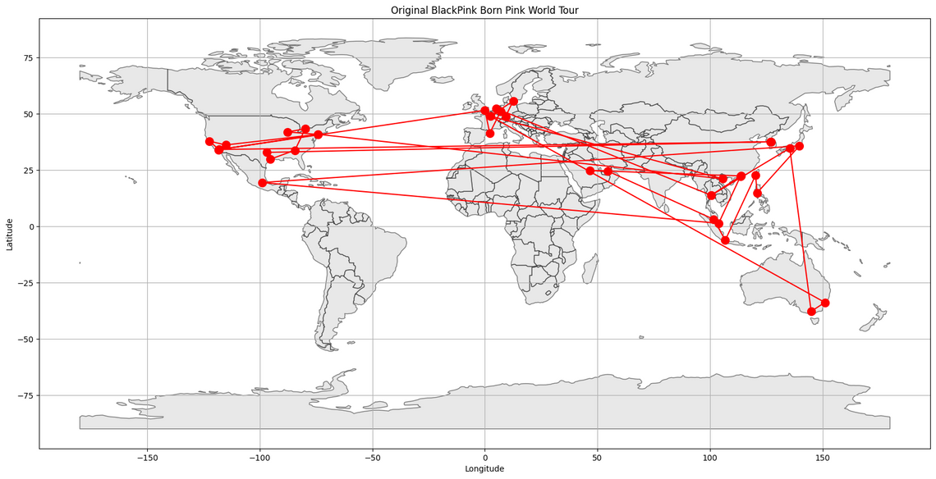
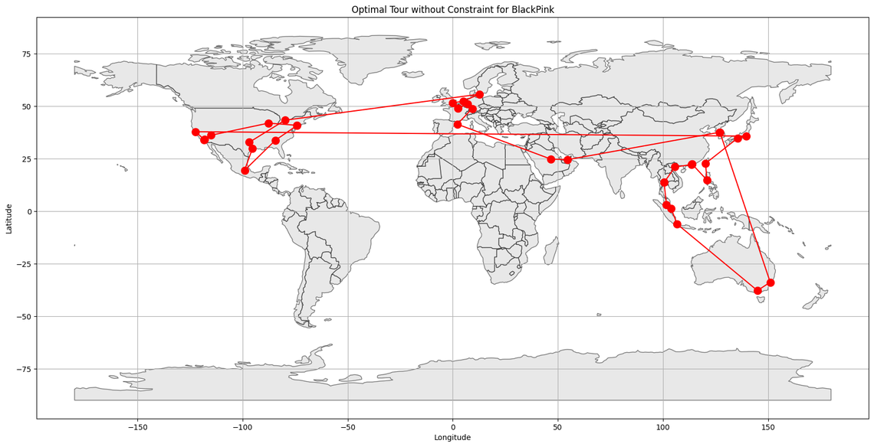
Distances without constraints
164,514.22 km
63,957.53 km
Reduced 100,556 km

Slide 27
TOUR SCHEDULE
Constraints:
Revisiting for encore should not be connected directly to the first visit
Start & end in Seoul
Updates:
Additional parameters: start_index, end_index, and min_distance.
evalTSP function: ensure the distance between cities > min_distance

Slide 28
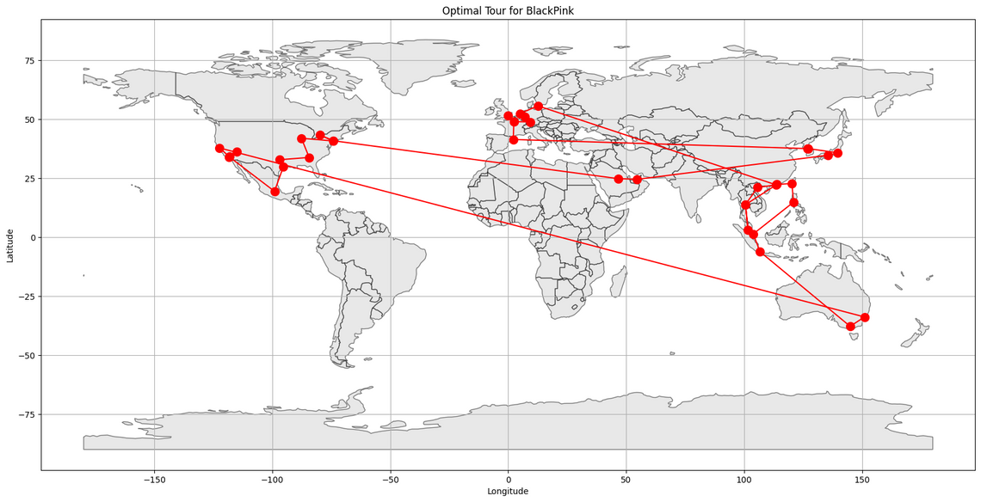
Distances with constraints:
(1) Start pt = index 0, End pt = index 37
(2) Minimum distances between nodes = 500 km
164,514.22 km
88,368.89 km
Reduced 76,122 km

Slide 29
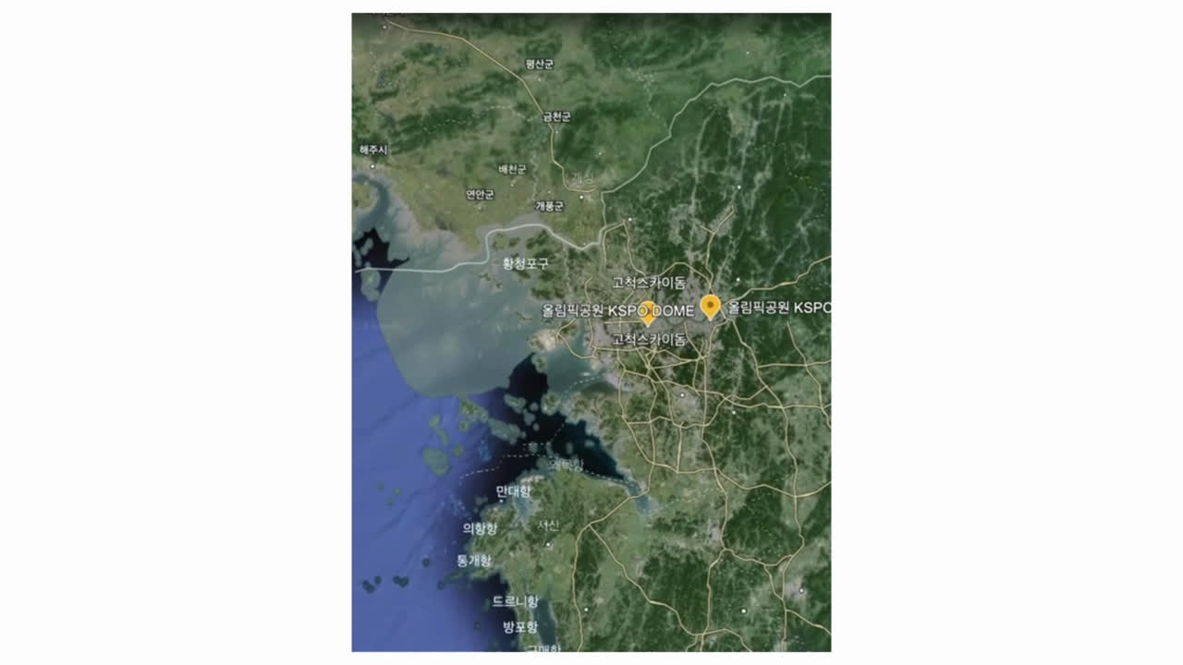
Notes:
That concludes our presentation on finding the best Blackpink world tour schedule using our algorithm designed for UPS.

Slide 30
REFERENCE
Anthropic. (2023). Claude. Claude.ai. https://claude.ai/chats
Kim, J.H. (2024). Genetic Algorithm. Lecture Resources on Algorithm Class (April 26). Retrieved from https://lms.handong.edu/courses/15331/external_tools/3
OpenAI. (2024). ChatGPT (April 26 version) [Large language model]. https://chat.openai.com

Slide 31




THANK YOU FOR LISTENING!
Don't hesitate to ask any questions!
Notes:
Thank you for your attention, and I'll be happy to take any questions you may have.

